Slide 1

Introducing Heron
By: Mathew Ankunda (2410642), Edward Tega (2179610) & Jodh Bhangal (2326991)

Slide 2
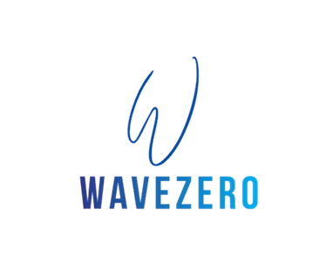

Slide 3

Challenge 2
Develop an integrated solution that synchronizes heating and lighting to minimise energy waste and improve indoor comfort.

Slide 4
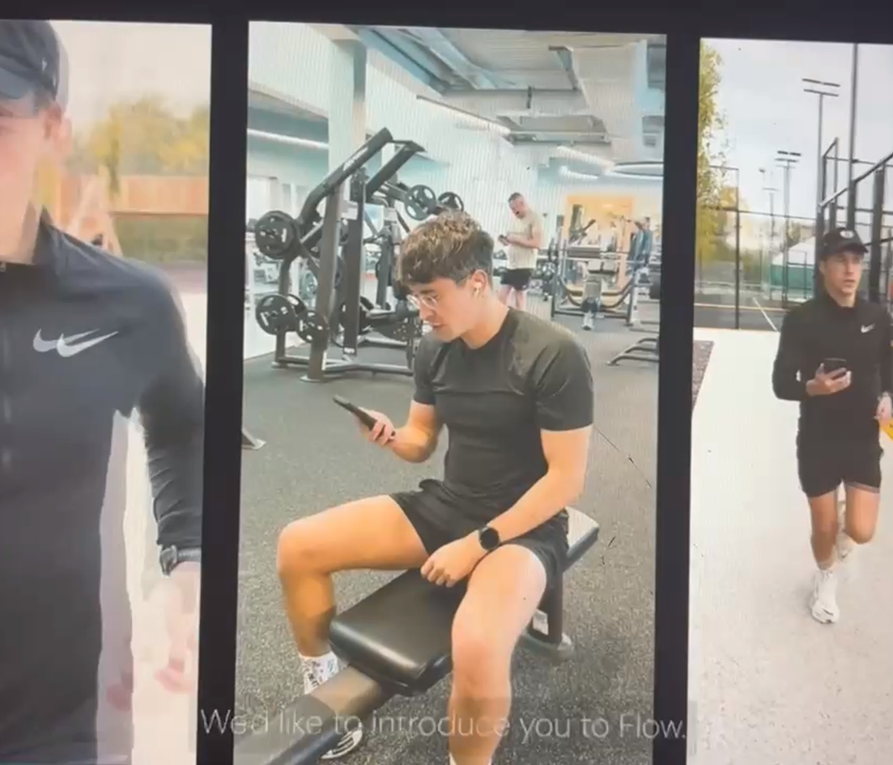
Innovation
Integrate API from SpeechMatics Flow.
Voice Recognition in new staff onboarding for security.
SpeechMatics' Ursa 2 model offers voice recognition across over 50 languages.
Global English language pack encompasses all major English accents.
Global Spanish language pack supports all major Spanish accents and dialects.

Slide 5
User Experience
Convenience & Accessibility (People with little to no experience from diverse cultures and ethnicities with the ability to communicate can use this system)
Accuracy & Reliability (Due to the computerized nature of voice recognition system's they're able understand speech clearly)

Slide 6
User Engagement
Pros:
-Enhanced Accessibility: supports individuals with disabilities by enabling hands-free interaction
-Role-Based Customization Improves Engagement: The hierarchical access model ensures that each user group has access to features relevant to their needs.
-Streamlined Operations and Increased Efficiency:
The system’s automation of energy management, combined with voice control, enables quick responses to changing conditions.

Slide 7
User Engagement
Cons:
Time to implement
Privacy concerns and User trust
Learning Curve and Onboarding Challenges

Slide 8
Technical Feasibility of VRS
Energy-Efficient Processing System: reduces energy use.
Automated control: managing lights and HVAC to save energy
Real-time adjustments: on-spot changes, improves energy efficiency
Scalable and Sustainable: various industries, helping them reduce carbon footprint and supporting sustainability.

Slide 9
Energy Source & Requirements
Solar energy
Solar panels (converts sunlight to electricity)
Designated specifically for the VRS
Energy storage (batteries to store excess energy during sunny periods and used during cloudy day or night-time)
Inverter Systems (used to convert DC to AC electricity produced by the solar panels)
Space & Location (dependent on the location, angle, and amount of sunlight. Most logical is the rooftops).

Slide 10
Energy Impact
1. Pros
Sustainable energy source (renewable, eco-friendly & minimized carbon footprint)
Reduced operating costs (reduced reliance on power grids)
Energy independence
(keeps the VRS operational even during peak energy demand times or grid outages)

Slide 11
Energy Impact
2. Cons
Inconsistent energy supply (reliance on backup power during cloudy days/nights increasing energy impact)
Storage limitations (when energy storage isn't sufficient (batteries), could lead to inefficient energy supply hence requiring backup systems)

Slide 12
System Requirements & Costs
High-Quality Quality Microphones (£50-£300)
Reliable Internet (£20-£100/month)
Noise Cancellation Technology (£100-£200)
Speech-Recognition Software (free-£80/month)
User Privacy and Security Features (variable)

Slide 13
Totality of System Setup Costs
Low-End Setup (£400 - £1000)
High-End Setup (£1000 - £3,500)

Slide 14
Financials
£50,000 – £80,000 (consultation, sensors, and network infrastructure planning)
£350,000 – £450,000 (expansion, AI model refinement, integration with other campus systems)
£300,000 – £400,000 (hardware, software, installation, AI training)
£50,000 – £100,000 annually (maintenance, AI updates, continued optimizations)

Slide 15
Financial Viability
Estimated 20-40% reduction in energy costs, leading to annual savings of £150,000–£300,000.
The maximum investment of £800,000 can be recovered within 3–6 years.
Long-term sustainability benefits, reduced operational expenses, and enhanced campus efficiency

Slide 16
Scalability
Modular Deployment
Cloud-Based Infrastructure
Smart grids, and Renewable Energy Sources.

Slide 17
Evaluating Technical Viability
Pros:
Energy Efficiency Using Automation
Hands Free Control
Seamless Integration With Smart Systems

Slide 18
Evaluating Technical Viability
Cons:
Privacy Concerns
Accuracy
Dependance on WiFi and Power Grids

Slide 19
How ARU will benefit
Energy cost reduction: 20-40% savings per year (~£200,000 to £300,000)
Sustainability impact: Lower carbon footprint
Operational efficiency: Reduced manual intervention, improved facility management
Student & faculty comfort: AI-driven adaptive environments improve productivity

Slide 20
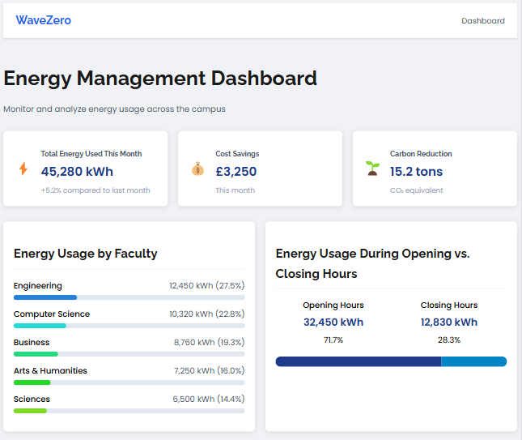
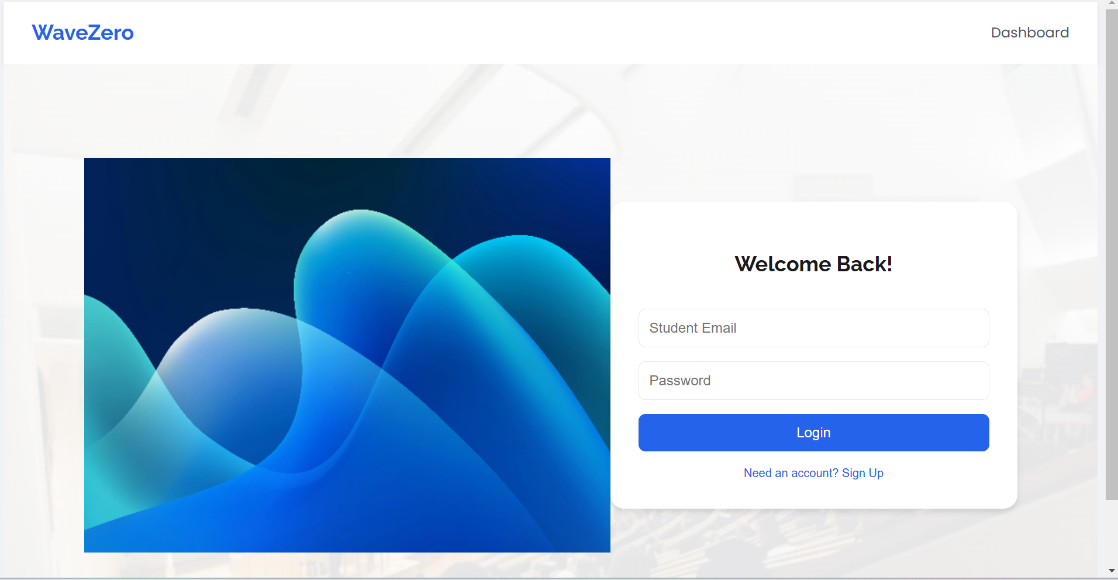
Dashboard prototypes

Slide 21
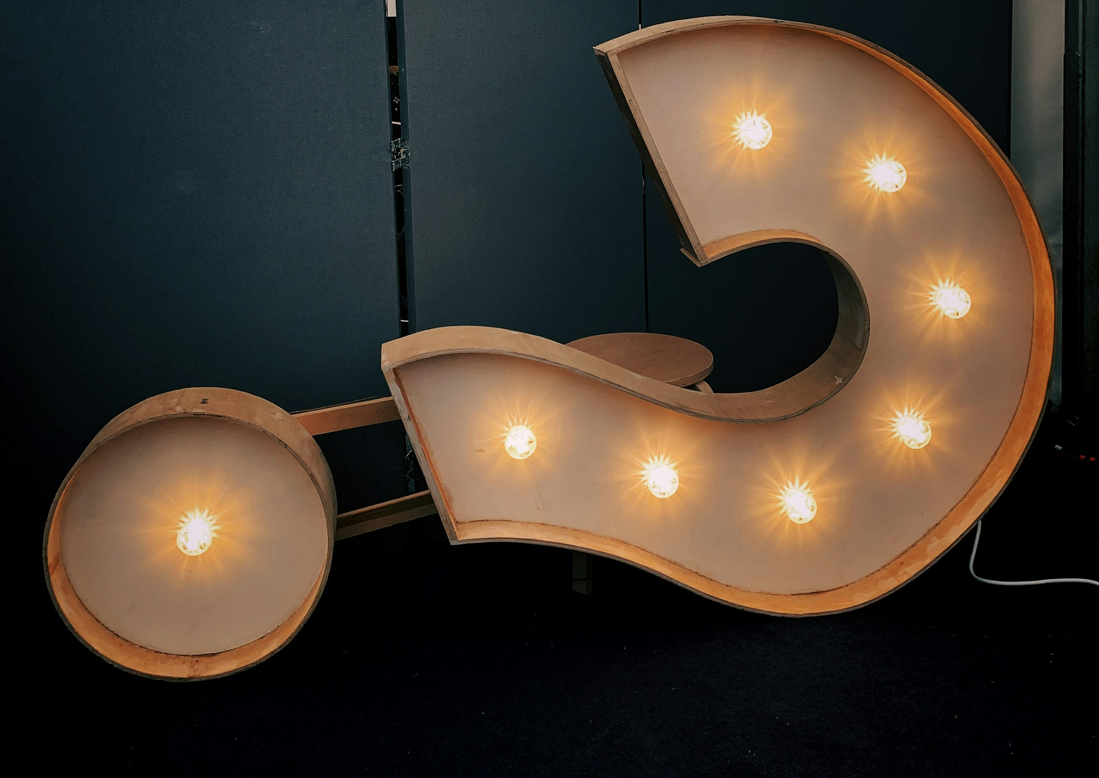
Q&A

Slide 22

WaveZero Thanks You !!!

